Slide 1
CSIT988/CSIT488 Security, Ethics and Professionalism Week 9: Risk management: identifying and assessing risk
Subject Coordinator: Guangyou Zhou
Central China Normal Univeristy
Spring 2024

Slide 2
Week | Lecture Topics | Readings
1 | Introduction and overview of the subject | Chapter 1 / No Tutorials
2 | Information security management | Chapter 1
3 | Planning for security | Chapter 2
4 | Planning for contingencies | Chapter 3
5 | Information security policy | Chapter 4
7 | Developing the security program | Chapter 5
8 | Security management models & practices | Chapter 6, 7
9 | Risk management: identifying and accessing risk | Chapter 8
10 | Risk management: controlling risk | Chapter 9
11 | Protection mechanisms | Chapter 10
12 | Personnel and security | Chapter 11
13 | Law and Ethics Exam Review | Chapter 12

Slide 3
Introduction
Information security departments are created primarily to manage IT risk
Managing risk is one of the key responsibilities of every manager within the organization
In any well-developed risk management program, two formal processes are at work
Risk identification and assessment (this lecture)
Risk control (next lecture)

Slide 4
Risk Management
If you know the enemy and know yourself, you need not fear the result of a hundred battles
If you know yourself but not the enemy, for every victory gained you will also suffer a defeat
If you know neither the enemy nor yourself, you will succumb in every battle”
-- Sun Tzu

Slide 5
Knowing Yourself
Identifying, examining and understanding the information and how it is processed, stored, and transmitted
Armed with this knowledge, one can initiate an in-depth risk management program
Risk management is a process
Safeguards and controls that are devised and implemented; are not install-and-forget devices

Slide 6
Knowing the Enemy
Identifying, examining, and understanding the threats facing the organization’s information assets
Must fully identify those threats that pose risks to the organization and the security of its information assets
Risk management
The process of assessing the risks to an organization’s information and determining how those risks can be controlled or mitigated
Risk analysis
Is the identification and assessment of levels of risk in the organization

Slide 7
Accountability for Risk Management
Communities of interest must work together
Evaluating the risk controls
Determining which control options are cost-effective
Acquiring or installing the appropriate controls
Overseeing processes to ensure that the controls remain effective
Identifying risks
Assessing risks
Summarizing the findings

Slide 8
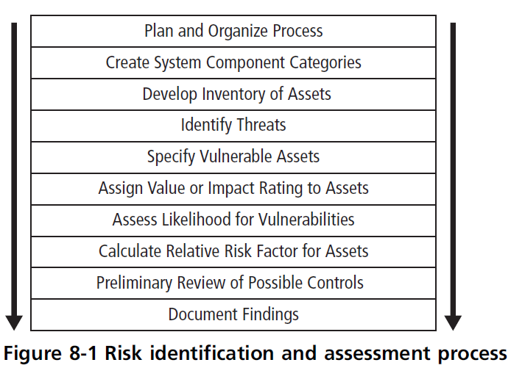
Risk Identification

Slide 9
Risk Identification (cont’d.)
Risk identification begins with the process of self-examination
Managers identify the organization’s information assets
Classify them into useful groups
Prioritize them by their overall importance

Slide 10
Creating an Inventory of Information Assets
Identify information assets
Includes people, procedures, data and information, software, hardware, and networking elements
This step should be done without pre-judging the value of each asset
Values will be assigned later in the process

Slide 11
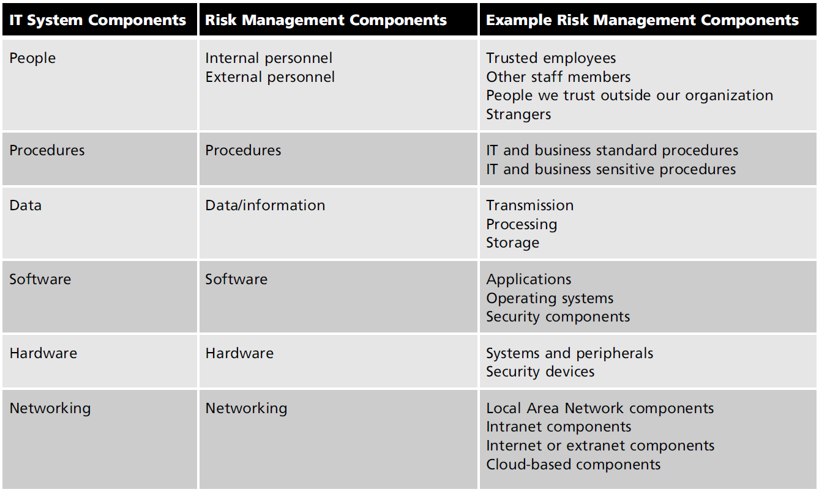
Model outline showing identified assets which are subcategorized into risk management components
Table 8-1 Organizational assets used in systems

Slide 12
Identifying hardware, software and network assets
Organizations use asset inventory systems to keep track of hardware, network and software components
Inventory process requires a certain amount of planning
Whether automated or manual
Determine which attributes of each information asset should be tracked
Depends on the needs of the organization and its risk management efforts

Slide 13
Creating an Inventory of Information Assets (cont’d.)
Potential asset attributes
Name, IP address
MAC address, asset type
Serial number, manufacturer name
Manufacturer’s model or part number
Software version, update revision or FCO (field change order) number
Physical location, logical location
Controlling entity

Slide 14
Identifying people, procedures and data assets
Responsibility for identifying, describing, and evaluating these information assets should be assigned to managers who possess the needed knowledge, experience, and judgment
As these assets are identified, they should be recorded using a reliable data-handling process like the one used for hardware and software
The record-keeping system should be flexible, allowing to link assets to attributes based on the nature of information asset being tracked.

Slide 15
Identifying people, procedures and data assets
Attributes for people, procedures, and data assets
People
Position name/number/ID
Supervisor name/number/ID
Security clearance level
Special skills
Procedures
Description
Intended purpose
Software/hardware/networking elements to which it is tied
Location where it is stored for reference
Location where it is stored for update purposes

Slide 16
Identifying people, procedures and data assets
Sample attributes for people, procedures, and data assets (cont’d.)
Data
Classification
Owner/creator/manager
Size of data structure
Data structure used
Online or offline
Location
Backup procedures

Slide 17
Classifying and Categorizing Assets
Determine whether the asset categories are meaningful
Inventory should also reflect each asset’s sensitivity and security priority
A classification scheme categorizes information assets based on their sensitivity and security needs
Each of these categories designates the level of protection needed for a particular information asset

Slide 18
Classifying and Categorizing Assets (cont’d.)
Some asset types, such as personnel, may require an alternative classification scheme that would identify the clearance needed to use the asset type
Classification categories must be comprehensive and mutually exclusive

Slide 19
Assessing Values for Information Assets
Assign a relative value:
As each information asset is identified, categorized, and classified
Comparative judgments made to ensure that the most valuable information assets are given the highest priority

Slide 20
Assessing Values for Information Assets
Relevant questions (cont’d.)
Which asset is the most critical to the success of the organization?
Which asset generates the most revenue?
Which asset generates the highest profitability?
Which asset is the most expensive to replace?
Which asset is the most expensive to protect?
Which asset’s loss or compromise would be the most embarrassing or cause the greatest liability?

Slide 21
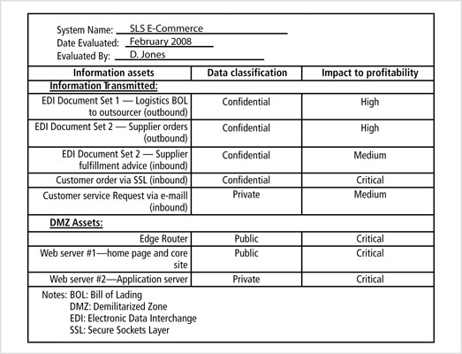
Figure 8-2 Sample asset classification worksheet

Slide 22
Listing Assets in Order of Importance
The final step in the risk identification process is to list the assets in order of importance
This goal can be achieved by using a weighted factor analysis worksheet

Slide 23
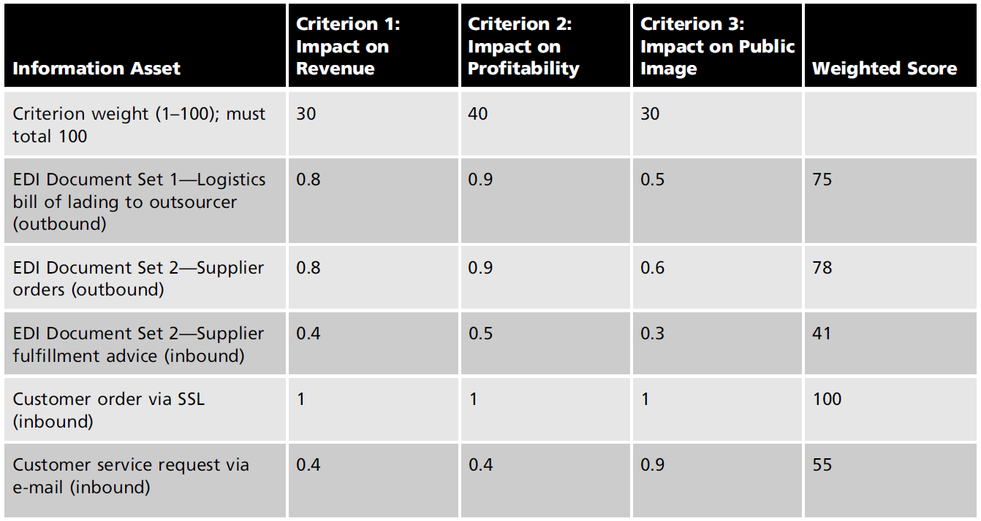
Listing Assets in Order of Importance (cont’d.)
Table 8-2 Example weighted factor analysis worksheet

Slide 24
Threat Identification
Any organization typically faces a wide variety of threats
If you assume that every threat can and will attack every information asset
The project scope becomes too complex
To make the process less unwieldy, each step in the threat identification and vulnerability identification processes is managed separately and then coordinated at the end

Slide 25
Threat Identification (cont’d.)
Each threat presents a unique challenge to information security
Must be handled with specific controls that directly address the particular threat and the threat agent’s attack strategy
Before threats can be assessed in the risk identification process
Each threat must be further examined to determine its potential to affect the targeted information asset
This process is a threat assessment

Slide 26
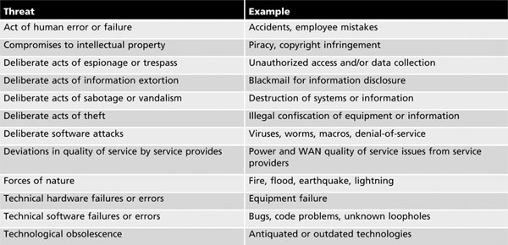
Threat Identification (cont’d.)
Table 8-3 Threats to information security

Slide 27
Vulnerability Assessment
Begin to review every information asset for each threat
This review leads to the creation of a list of vulnerabilities that remain potential risks to the organization
Vulnerabilities are specific avenues that threat agents can exploit to attack an information asset
At the end of the risk identification process, a list of assets and their vulnerabilities has been developed
This list serves as the starting point for the next step in the risk management process - risk assessment

Slide 28
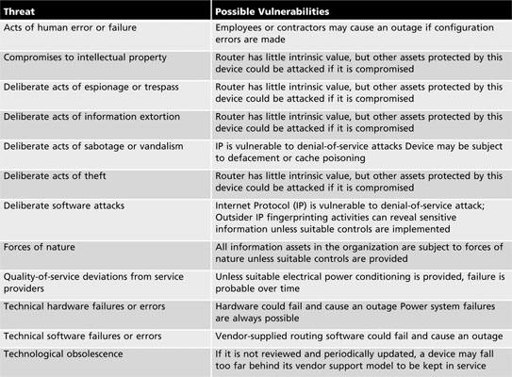

Slide 29
The TVA Worksheet
At the end of the risk identification process, a list of assets and their vulnerabilities has been developed
Another list prioritizes threats facing the organization based on the weighted table discussed earlier
These lists can be combined into a single Threats-Vulnerabilities-Assets (TVA) worksheet
T1V1A1—Vulnerability 1 that exists between Threat 1 and Asset 1
T1V2A1—Vulnerability 2 that exists between Threat 1 and Asset 1
T2V1A1—Vulnerability 1 that exists between Threat 2 and Asset 1

Slide 30
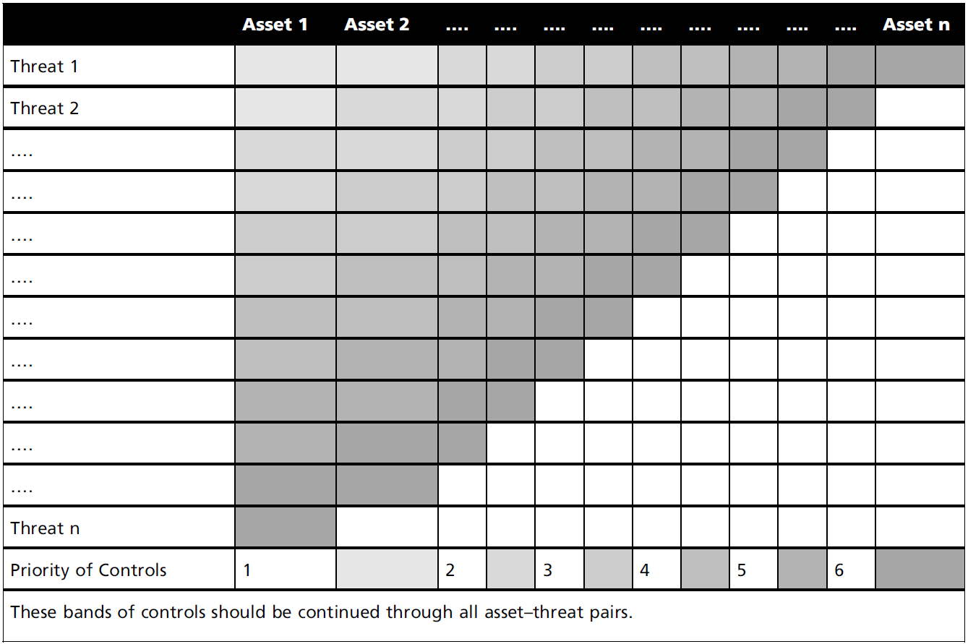

Slide 31
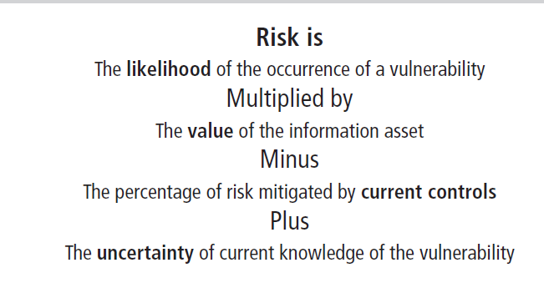
Risk Assessment
The goal is to create a method to evaluate the relative risk of each listed vulnerability
Figure 8-3 Risk identification estimate factors

Slide 32
Likelihood
The overall rating of the probability that a specific vulnerability will be exploited
Often using numerical value on a defined scale (such as 0.1 – 1.0)
Using the information documented during the risk identification process, you can assign weighted scores based on the value of each information asset, i.e. 1-100, low-med-high, etc

Slide 33
Assessing Potential Loss
Questions to ask when assigning likelihood values
Which threats present a danger to this organization’s assets in the given environment?
Which threats represent the most danger to the organization’s information?
How much would it cost to recover from a successful attack?
Which threats would require the greatest expenditure to prevent?
Which of the aforementioned questions is the most important to the protection of information from threats within this organization?

Slide 34
Percentage of Risk Mitigated by Current Controls
If a vulnerability is fully managed by an existing control, it can be set aside
If it is partially controlled, estimate what percentage of the vulnerability has been controlled

Slide 35
Uncertainty
It is not possible to know everything about every vulnerability
The degree to which a current control can reduce risk is also subject to estimation error
Uncertainty is an estimate made by the manager using judgment and experience

Slide 36
Risk Determination
Example
Asset A has a value of 50 and has one vulnerability, which has a likelihood of 1.0 with no current controls. Your assumptions and data are 90% accurate
Asset B has a value of 100 and has two vulnerabilities:
vulnerability #2 has a likelihood of 0.5 with a current control that addresses 50% of its risk;
vulnerability # 3 has a likelihood of 0.1 with no current controls. Your assumptions and data are 80% accurate

Slide 37
Risk Determination (cont’d.)
Example (cont’d.)
The resulting ranked list of risk ratings for the three vulnerabilities is as follows:
Asset A: Vulnerability 1 rated as
55 = (50 × 1.0) *(100% – 0% + 10%)
Asset B: Vulnerability 2 rated as
35 = (100 × 0.5) *(100%– 50% + 20%)
Asset B: Vulnerability 3 rated as
12 = (100 × 0.1) *(100% – 0 % + 20%)

Slide 38
Likelihood and Consequences
Likelihood and consequence rating
Another approach
From the Australian and New Zealand Risk Management Standard 4360
Uses qualitative methods of determining risk based on a threat’s probability of occurrence and expected results of a successful attack

Slide 39
Likelihood and Consequences (cont’d)
Likelihood and consequence rating (cont’d.)
Consequences (or impact assessment) are evaluated on 5 levels ranging from insignificant (level 1) to catastrophic (level 5), as assessed by the organization

Slide 40
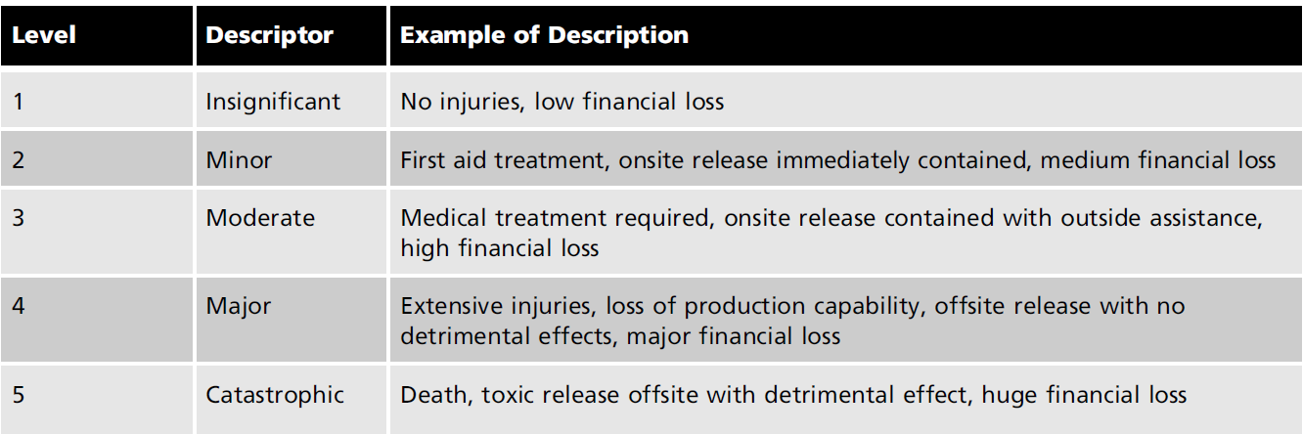
Likelihood and Consequences (cont’d)

Slide 41
Likelihood and Consequences (cont’d)
Likelihood and consequence rating (cont’d.)
Qualitative likelihood assessments levels are represented by values ranging from A (almost certain) to E (rare), as determined by the organization

Slide 42
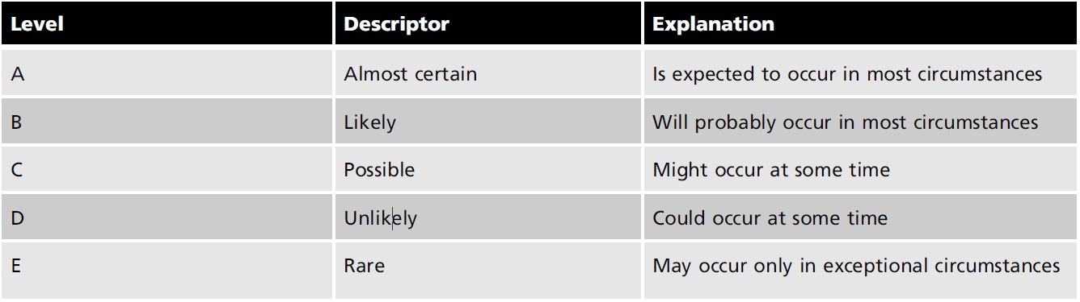
Likelihood and Consequences (cont’d)

Slide 43
Identify Possible Controls
For each threat and its associated vulnerabilities that have residual risk, create a preliminary list of control ideas
Purpose of this list: to identify areas of residual risk that may nor may not need to be reduced:
- residual risk is the risk that remains even after the existing control has been applied
Three general categories of controls exist:
Policies
Programs
Technical controls

Slide 44
Likelihood and Consequences (cont’d.)
Consequences and likelihoods are combined
Enabling the organization to determine which threats represent the greatest danger to the organization’s information assets
The resulting rankings can then be inserted into the TVA tables for use in risk assessment

Slide 45
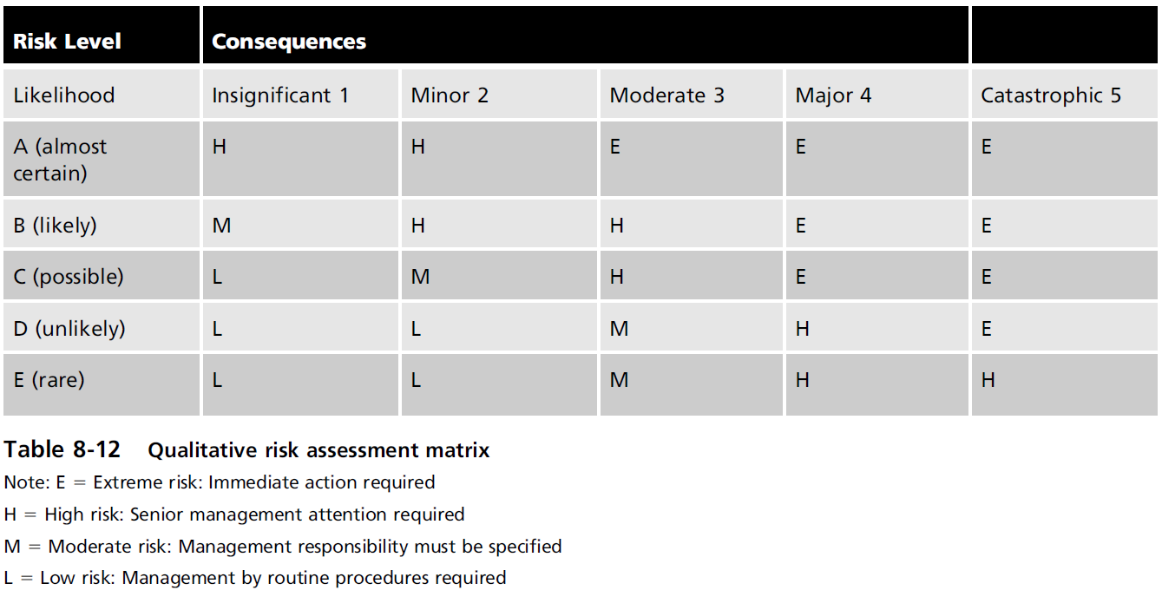
Likelihood and Consequences (cont’d.)

Slide 46
Documenting the Results of Risk Assessment
Goals of the risk management process
To identify information assets and their vulnerabilities
To rank them according to the need for protection
In preparing this list, a wealth of factual information about the assets and the threats they face is collected

Slide 47
Documenting the Results of Risk Assessment (cont’d.)
Information about the controls that are already in place is also collected
The final summarized document is the ranked vulnerability risk worksheet

Slide 48
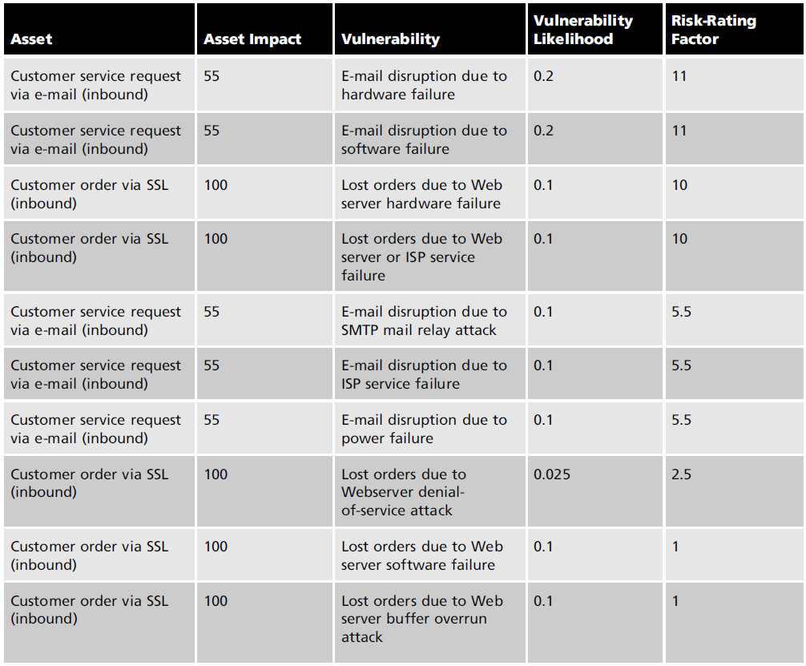

Slide 49
Documenting the Results of Risk Assessment (cont’d.)
What should the documentation package look like?
What are the deliverables from this stage of the risk management project?
The risk identification process should designate what function the reports serve, who is responsible for preparing them, and who reviews them

Slide 50
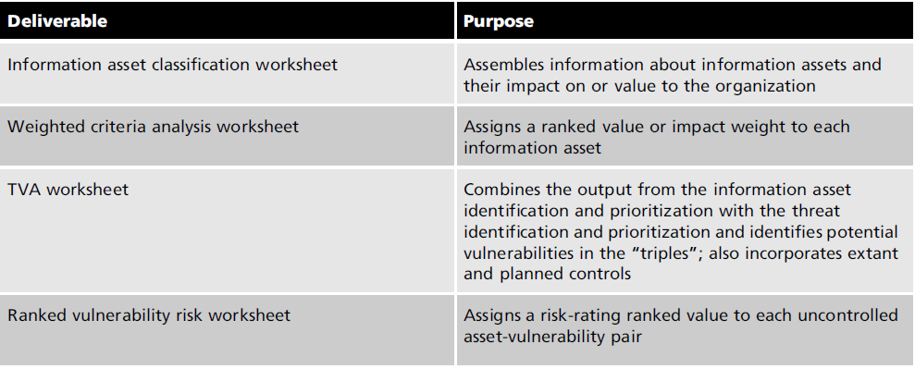
Documenting the Results of Risk Assessment (cont’d.)

